Slide 1
Ch. 13 At a Glance
Argument Essays: pp. 213-

Slide 2

Writing to Influence
Persuasion is the key to writing scholarly arguments
This means you are trying to influence people to think a certain way or do something.

Slide 3

What is an argument?
In scholarly terms, it is persuasion on a topic about which reasonable people disagree.

Slide 4
Formal/Informal Arguments
Op ed news articles tend to be informal.
Social medial sites are a display of informal arguments
Scholarly arguments are formal and require a tight structure
The “proposition” is the key component of the argument—it is the main point

Slide 5
Backing up your proposition
Requires support, evidence, and reasons.

Slide 6
College Essay Argument
Background—historical or social context for the issue
Proposition—The thesis or what you want your audience to believe or do
Qualification of proposition—limiting the argument so that it cannot easily be challenged
Refutation—taking the opposing view into account, mainly to show that it is flawed
Support—facts, examples, statistics, and opinions of authoritative sources

Slide 7
Evidence
When building an argument, think of ways to present the evidence
FACTS
EXAMPLES
STATISTICS
EVIDENCE

Slide 8
Facts
Some facts are common knowledge and easily verifiable
Other facts are opinions of authoritative sources and are highly regarded
Source material is key to a good argument essay

Slide 9
Examples
Use of examples seen in the media or in culture can be appropriate
Relevance is the key

Slide 10
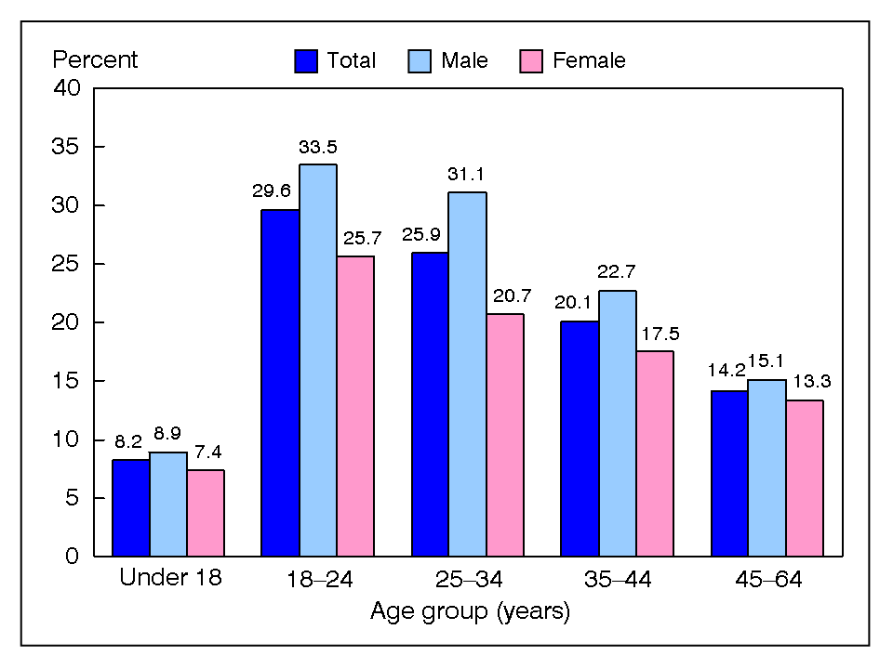
Statistics
Numerical data can make an argument much more convincing
Makes sure not to overwhelm your readers with too much data, however.

Slide 11
Authoritative Voices
Evidence from authorities or experts in the field are highly regarded in scholarly writing
Can include books, periodicals, journals, and other reference materials
Be careful when using general publications—they are meant to entertain, not educate.

Slide 12

When mentioning your authoritative voices in your essay, you often cite and identify his/her credentials
Use many authoritative sources to build your credibility.

Slide 13
VOICE
Most arguments sound more convincing when writing in the third-person voice.
Some proposals are for specific purposes; therefore, first person voice may work well.
Cartoons and animated programs today encourage children to be violent.
I think cartoons and animated programs today encourage children to be violent.

Slide 14
Student Sample
Pp. 228—Reading Based Writing—Argument (this one uses only one resource)
Refer also to Ch. 4 on reading based writing and Ch. 13 for research writing style and format.
SAMPLES:
Look at articles on anti-intellectualism
A look at the persuasive argument for wind turbines

